Slide 1
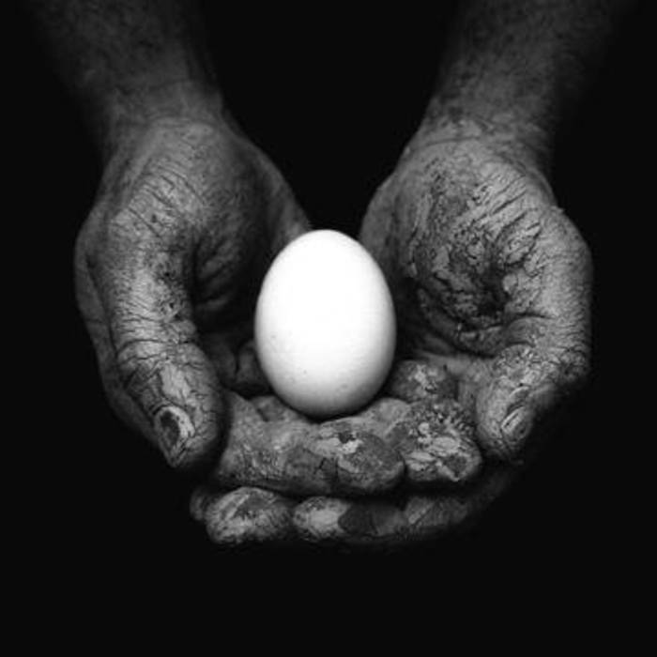

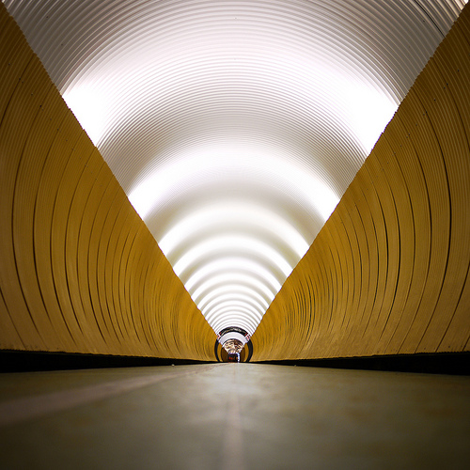


©Getty Images
©Chiarascuro
Point – a location in space
Source: Pinterest
©Mikel Ortega
©Eolo Perfido

Slide 2

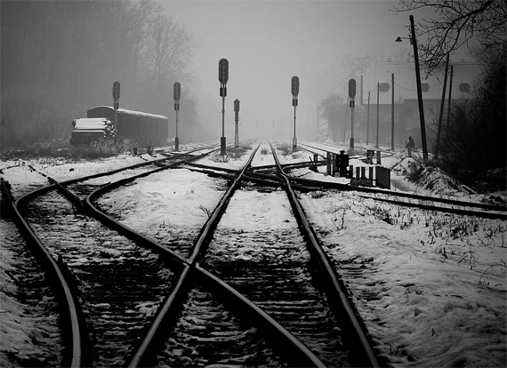
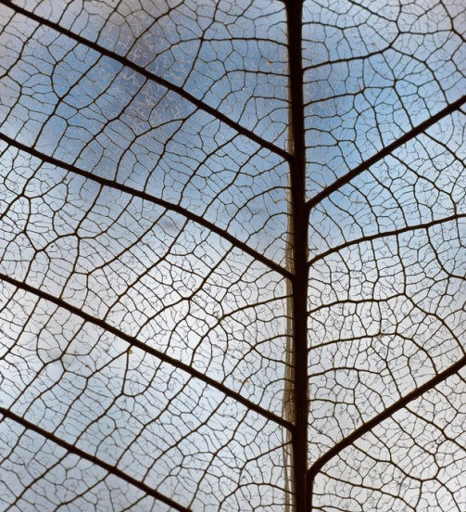
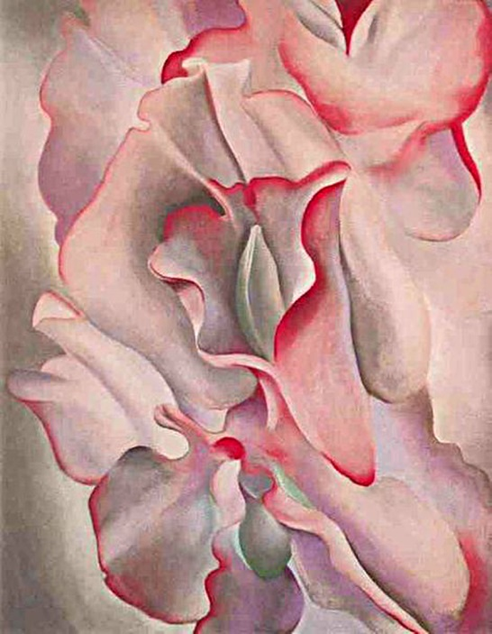
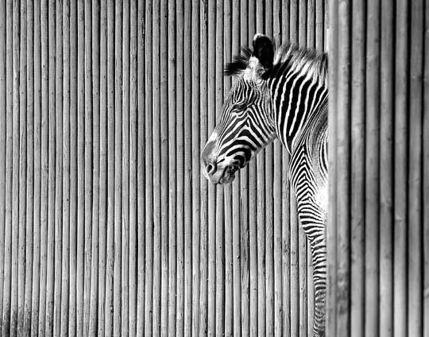
©Shutterstock
Source: Unknown
©Chris Maher
Source: Unknown
©Georgia O’Keefe
Line – voice the feminine

Slide 3

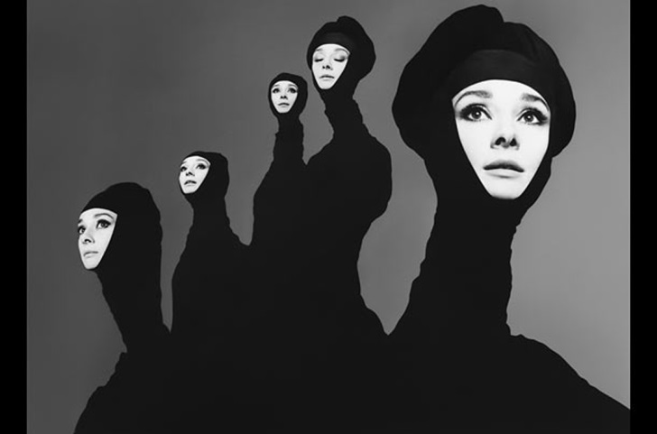
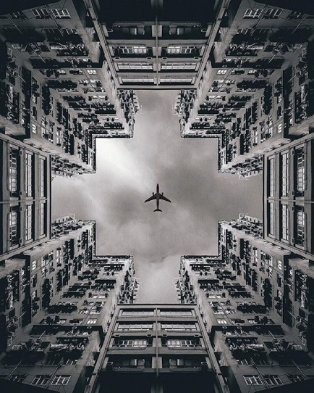
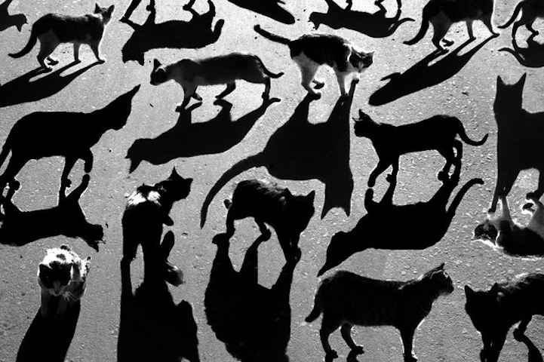
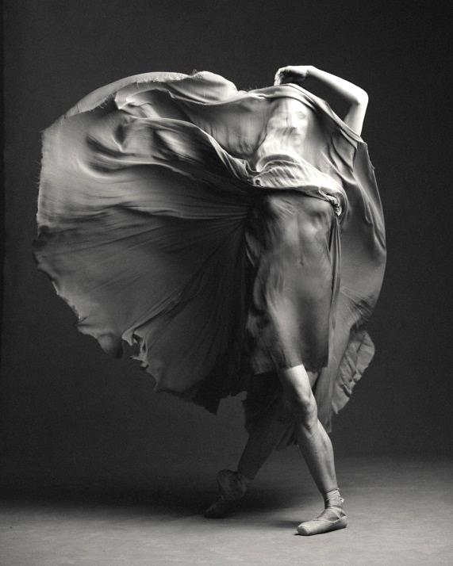
Source: Unknown
Source: 123rf
©Richard Avedon
©Alexey Bednij
Shape – describe area
©Karolina Kuras

Slide 4


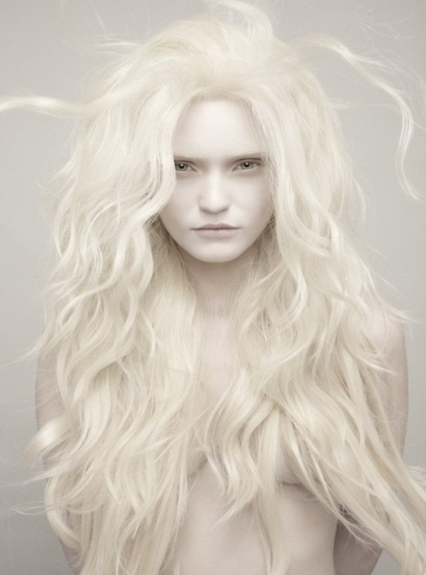
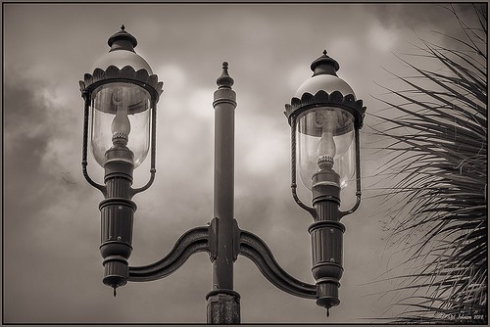
©Chris Dale
Source: Unknown
©Javier Garcheche
©Luis de las Alas
Tone – suggest mood
Source: Unknown

Slide 5
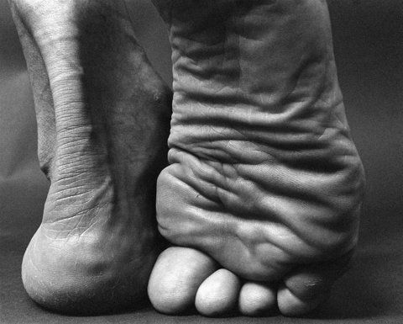
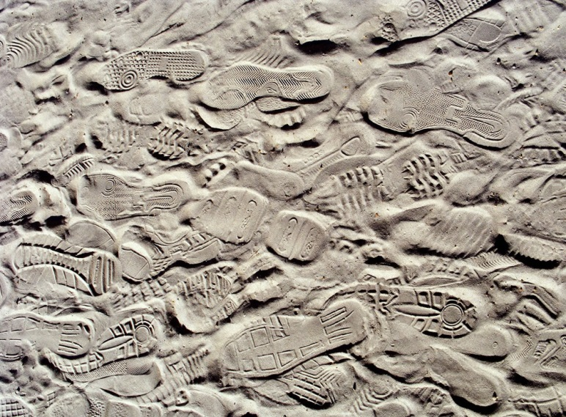
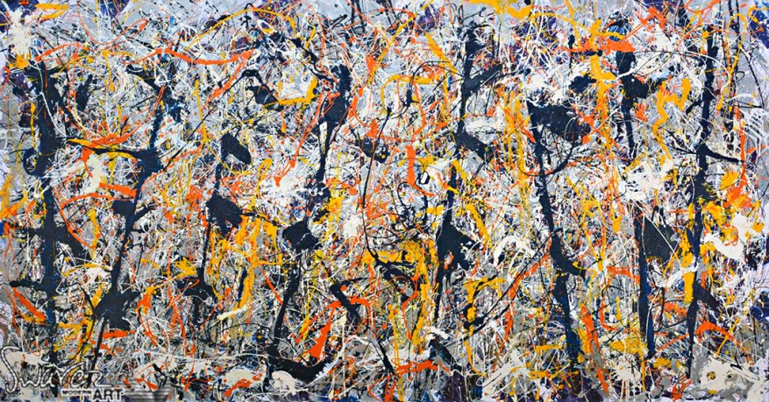
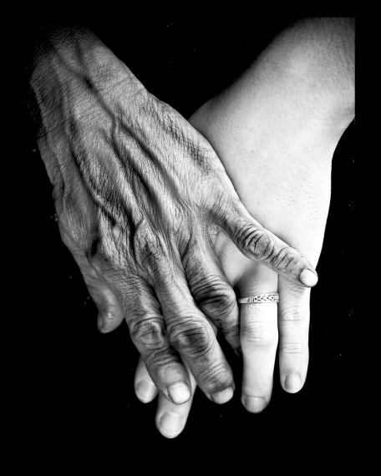
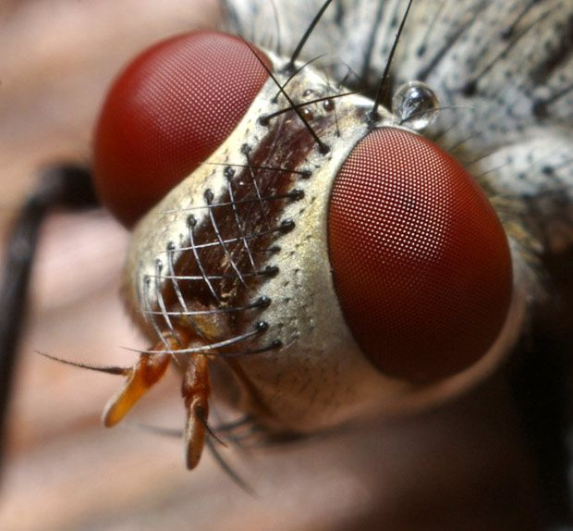
Source: Unknown
Source: Unknown
©Jackson Pollock
©Thomas Shahan
Source: Unknown
Texture – depict surface

Slide 6
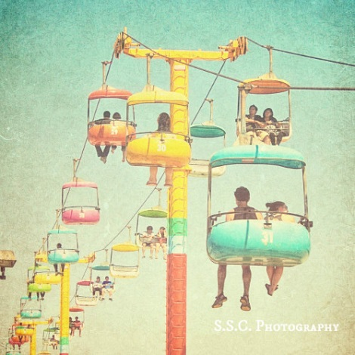
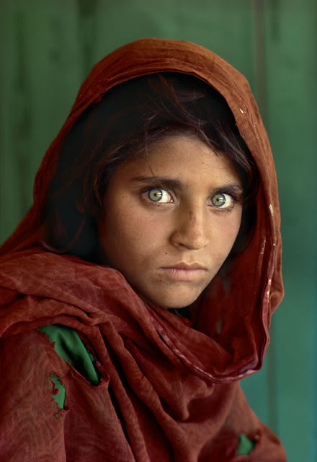
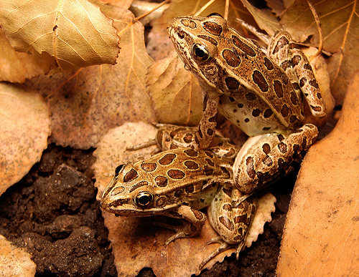
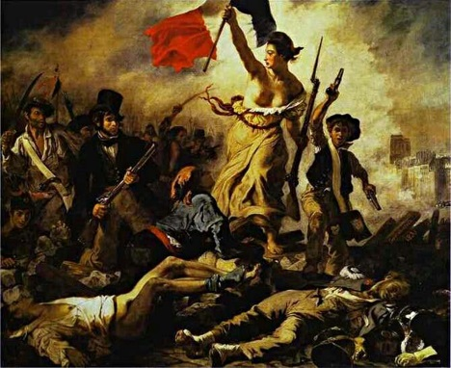
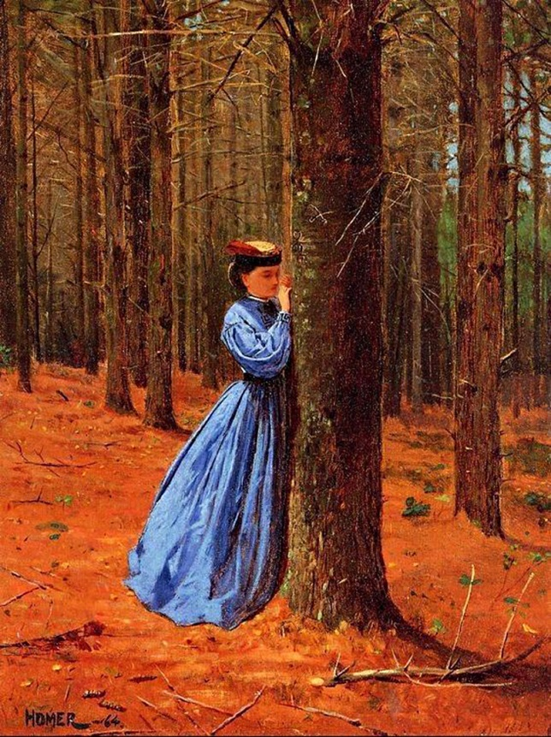
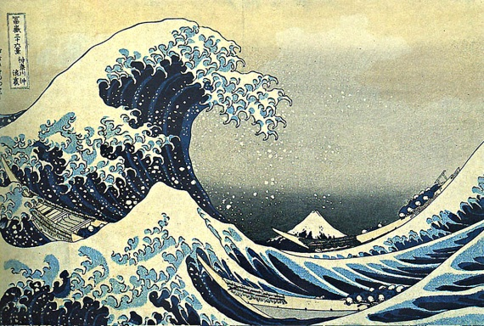
©SSC Photography
©Matt Reinbold
Eugene Delacroix
©Steve McCurry
Colour –
express
feeling
Katsushika Hokusai
©Winslow Homer

Slide 7
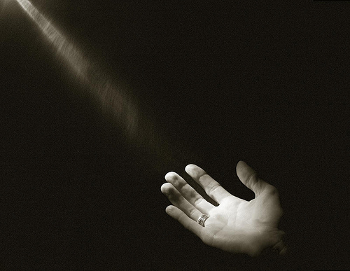



Source: Unknown
©Lea Tippett
Source: Unknown
Source: Unknown
Space – convey depth

Slide 8
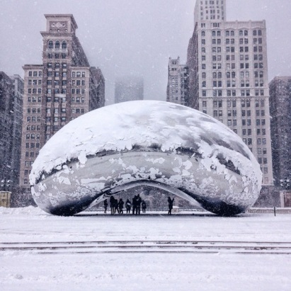
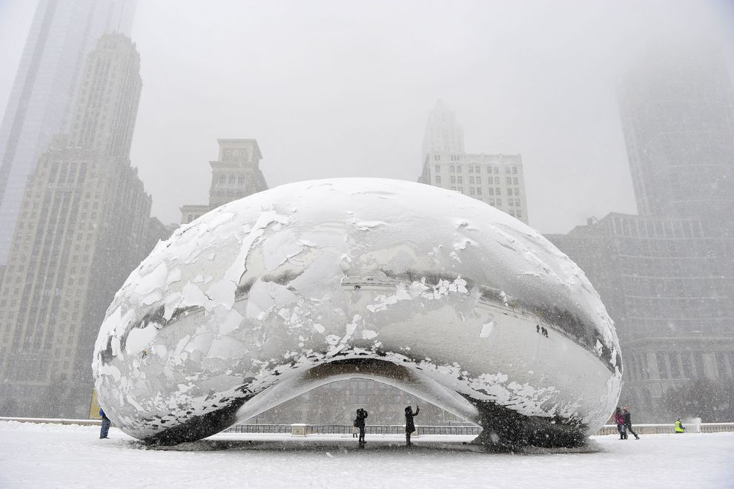
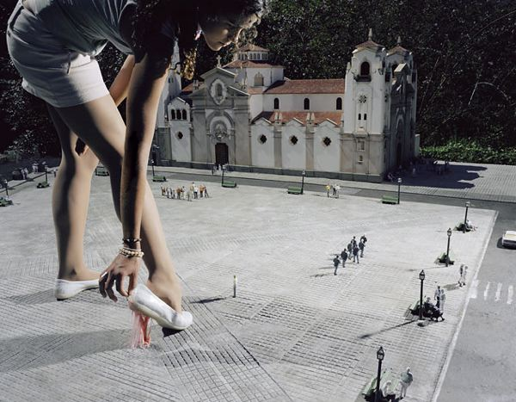
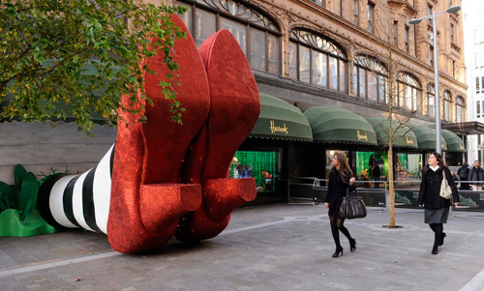

©Brian Kersey
Source: Unknown
Source: Unknown
Scale – show size
©Corey Mondello

Slide 9
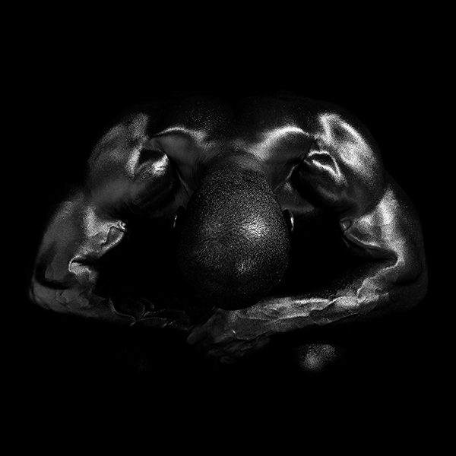


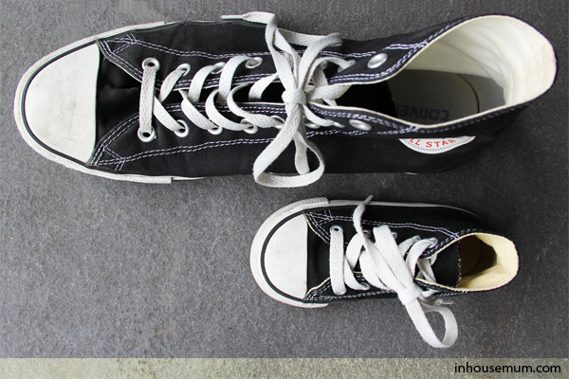
©Val Tourchin
©OrangeAcid
Source: Unknown
Source: Unknown
Contrast – reveal drama

Slide 10

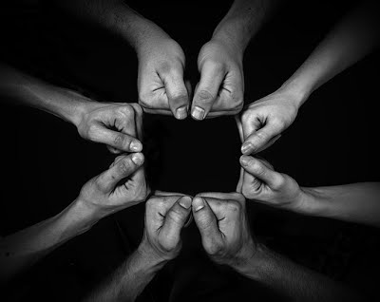
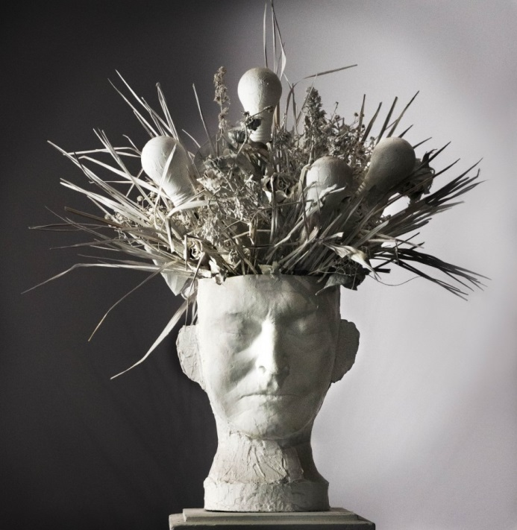
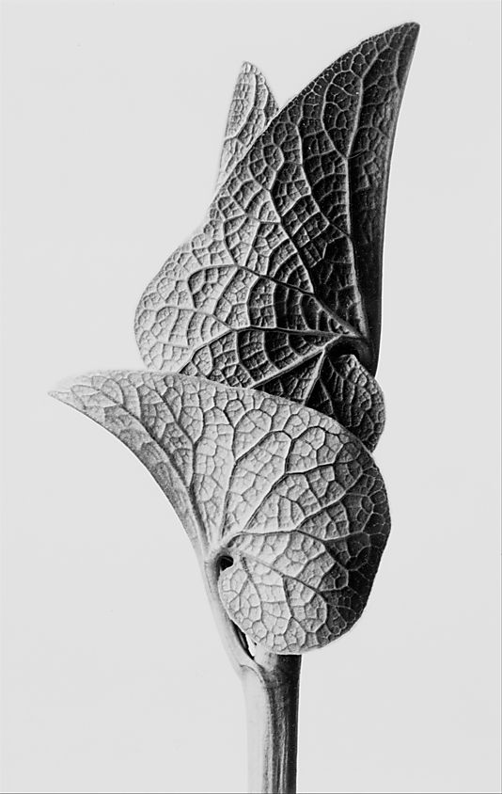
Source: Unknown
Source: Unknown
Source: Unknown
Form –
define volume
©Karl Blossfeldt

Slide 11
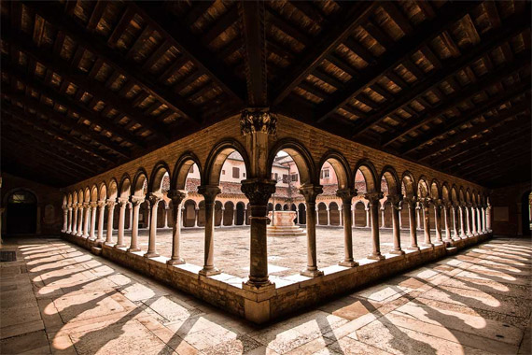


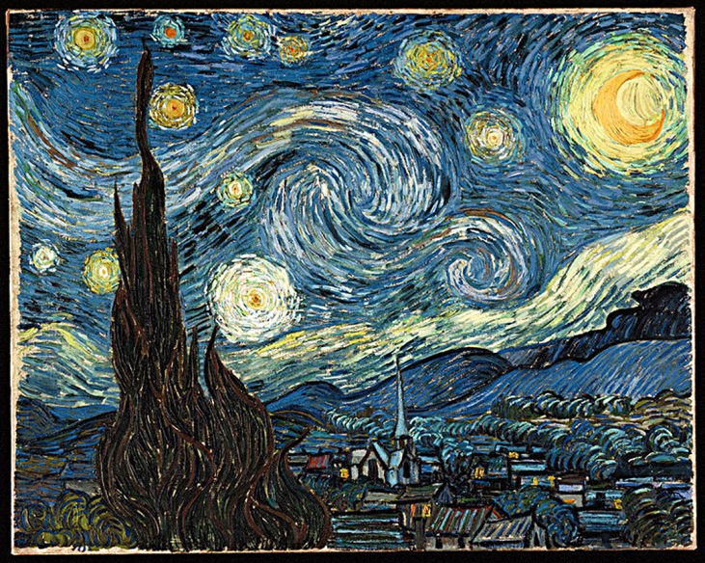
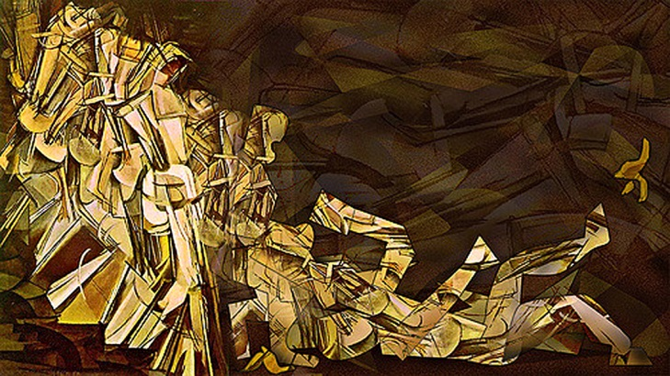
Source: Unknown
©Ron Coscorrosa
Source: Unknown
Marcel Duchamp
Vincent Van Gogh
Repetition and
rhythm – create tempo

Slide 12
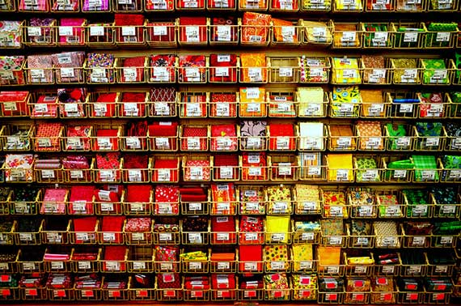
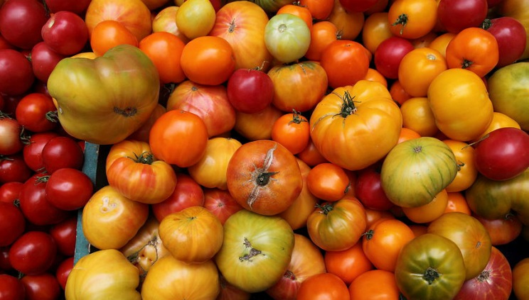

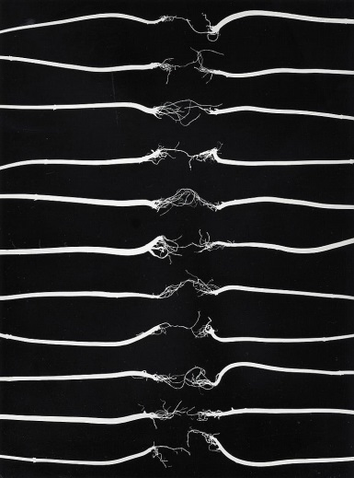
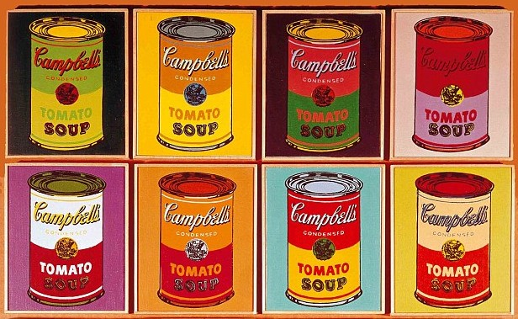
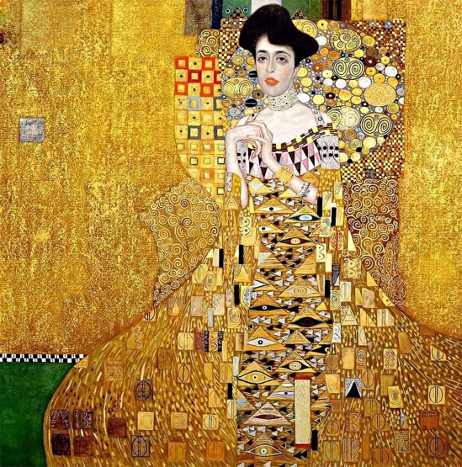
Source: Unknown
Source: Unknown
Source: Unknown
Andy Warhol
Gustav Klimt
Source: Unknown
Unity and variety –
portray similarity

Slide 13


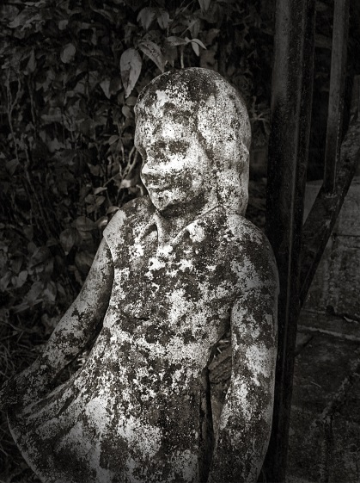
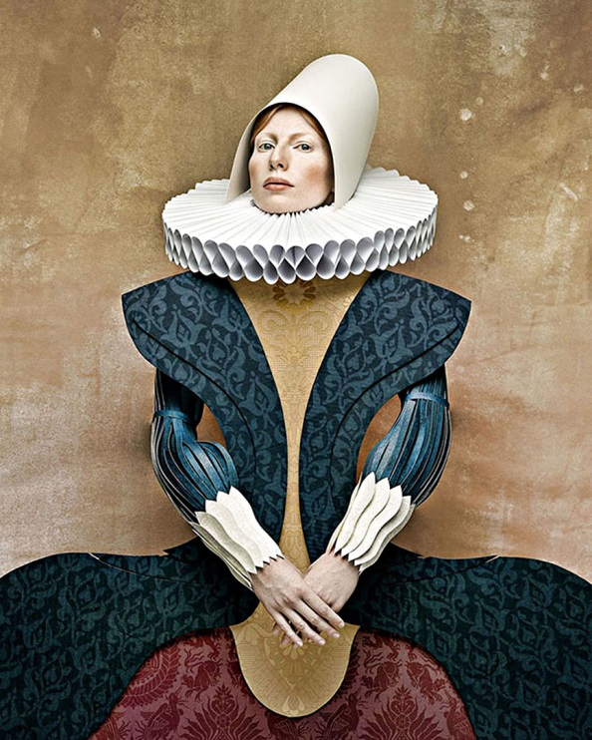

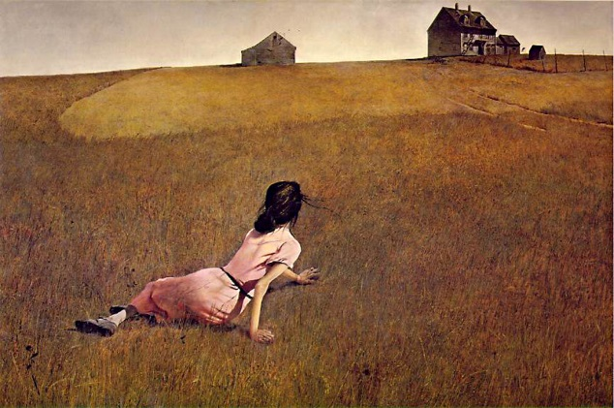
Source: Unknown
Source: Unknown
Source: Unknown
Source: Unknown
©Andrew Wyeth
Dominance and
subordination – emphasise rank
Source: Unknown

Slide 14


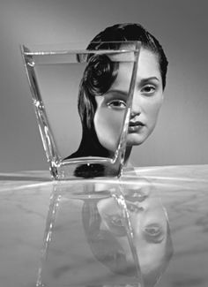
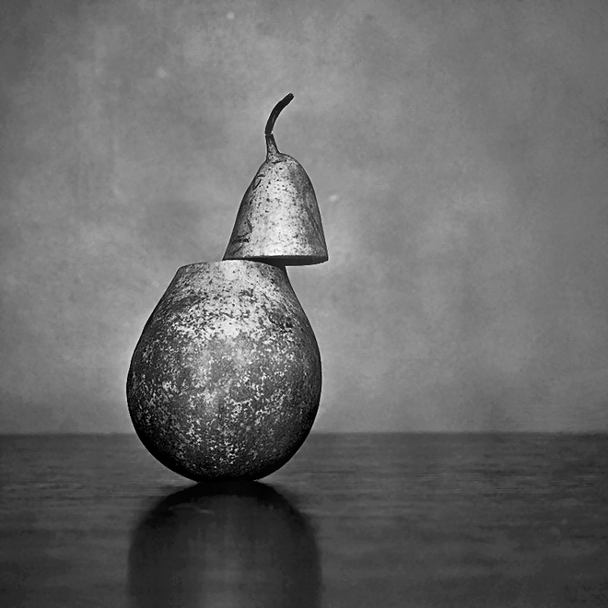
Source: Unknown
Source: Unknown
Source: Unknown
Balance and
symmetry – place off-kilter
Source: Unknown

Slide 15
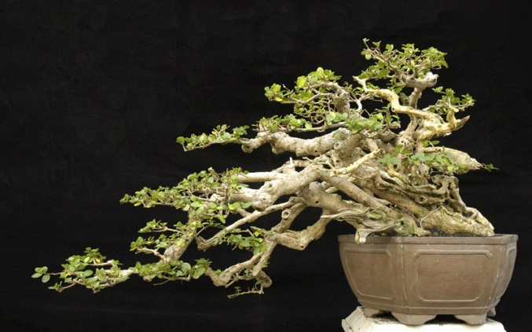
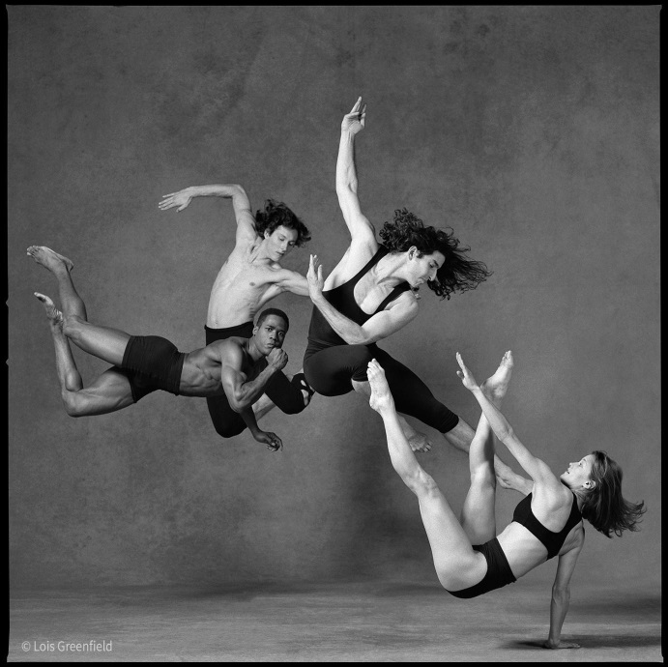
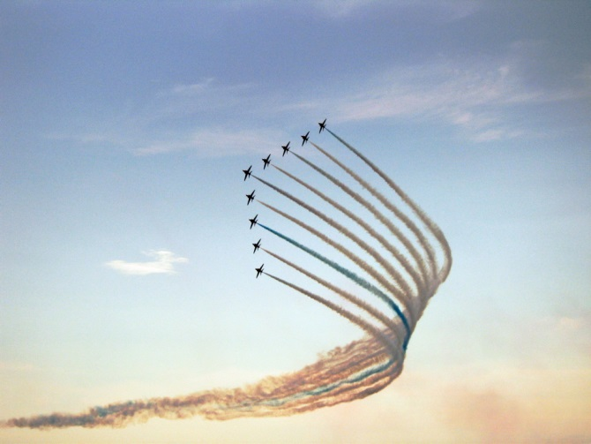
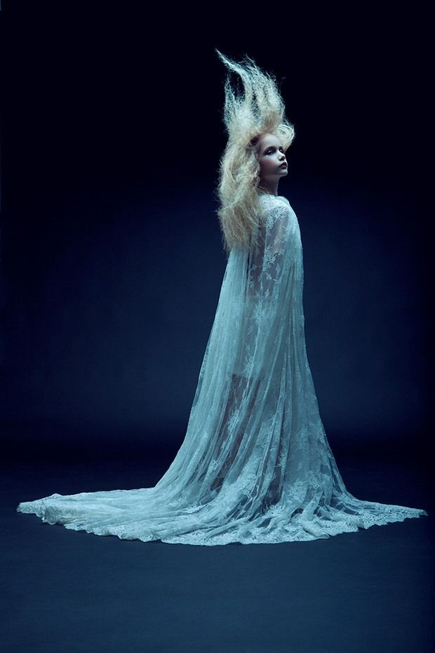
Source: Unknown
Source: Unknown
©Lois Greenfield
Directional force – imply motion
Source: Unknown

Slide 16




Source: Unknown
Source: Unknown
Representation
and abstraction –
investigate detail
Source: Unknown
Source: Unknown

Slide 17




Source: Unknown
Source: Unknown
Source: Unknown
©Richard Avedon
Gesture – illustrate attitude

Slide 18




Source: Unknown
Source: Unknown
Symbol –
tell two stories
Source: Unknown
Source: Unknown

